Slide 1
Arduino Communication
APPS Summer Camp 2021
Bohdan Hlovatskyi. Karyna Volokhatiuk

Slide 2
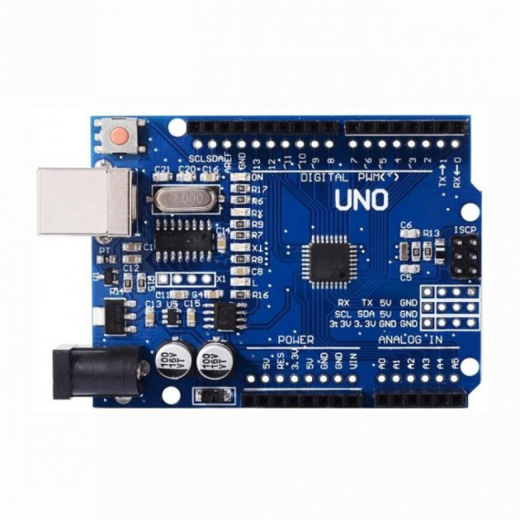
Pins for common
communication protocols

Slide 5
Asynchronous Serial Transmission

Slide 6
Synchronous Serial Transmission.

Slide 8
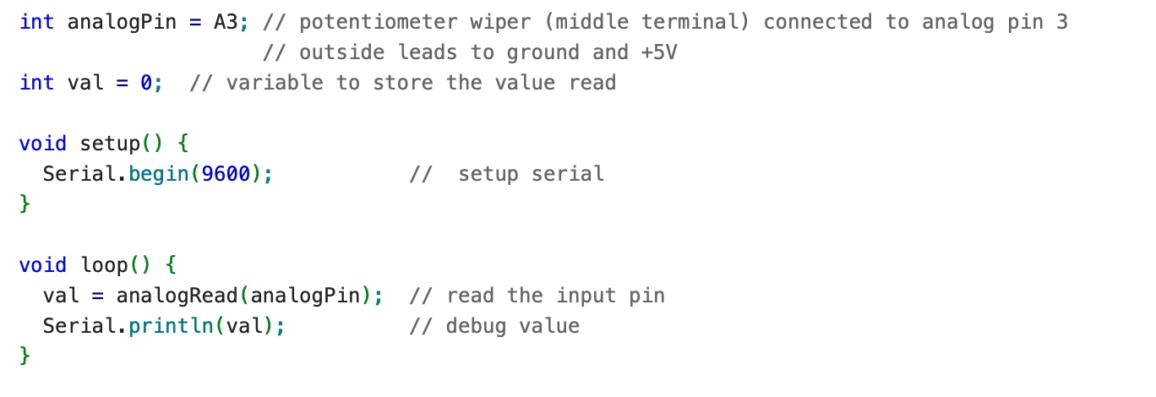
analogRead()

